Slide 1

Automated Speaker Verification - A Study in Deep Neural Networks and Transfer Learning
COMP9444 Neural Networks and Deep Learning
Yash Khandelwal, Ahmet Karatas, Damian Basso and Armaan Bhullar
School of Computer Science and Engineering
Faculty of Engineering
The University of New South Wales, Sydney, Australia
Notes:
Dsfsdf
Sdfsd
Dsf
Fds
F
f

Slide 2
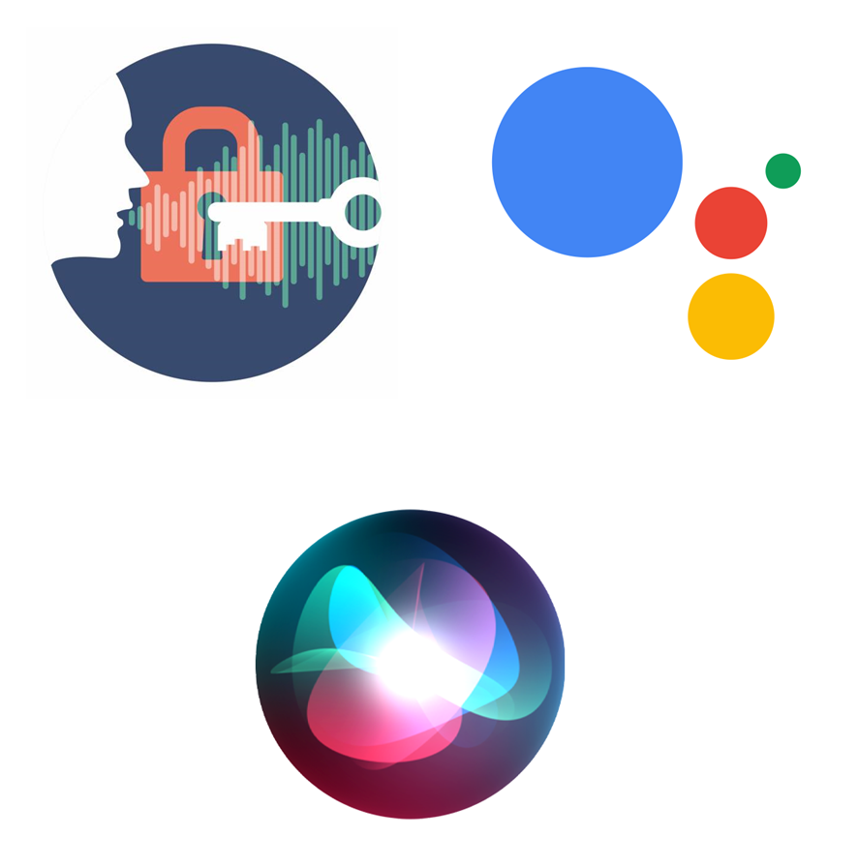
Motivation
"Identity theft is not a joke" - Dwight Shrute, The Office
Identifying a speaker is key in:
The functioning of virtual assistants
Verifying users for online banking
Voice Biometry
Voice-to-text transcription
Human voices however differ exorbitantly:
Different Dialects
Wide array of words/sounds
Background noise
Tone and pace
Notes:
Dsfdsfdsdfdsfsdfsdf
Dsfsdf
Sdfds
Df
Sdsfs
Dsfdsffsd
Dsff
Sdfdsf
Dsfs
Dfdsf
Ds
F
Fsdf
dsfsdfds

Slide 3
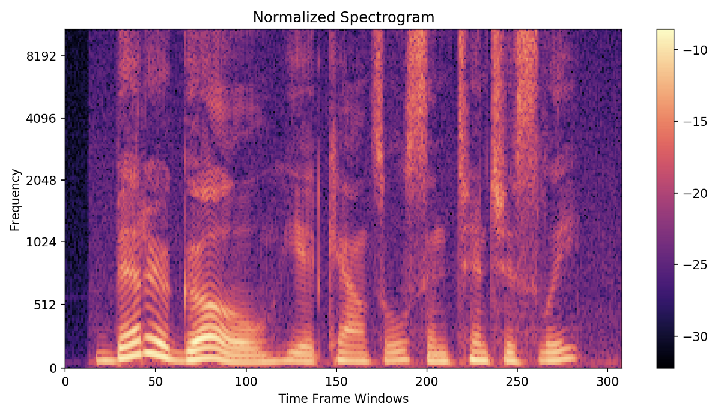
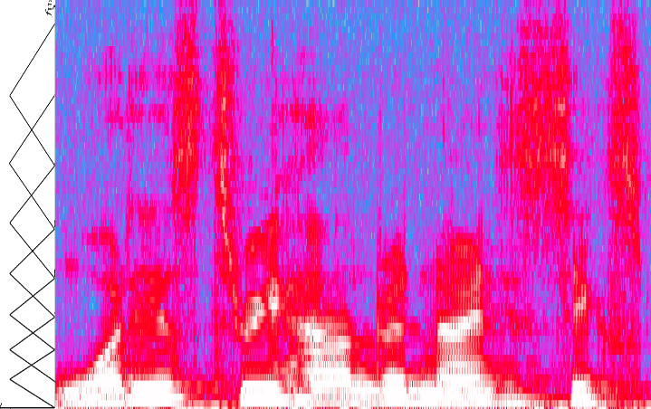
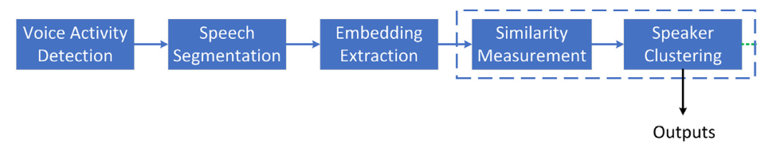
Data Exploration
VoxCeleb
7,000+ speakers
1,000,000 utterances
2,000+ hours audio
Transfer learning
Filter Banks
Raw audio into usable data
Data compression
Stage-wise Speaker Diarisation
Image source: Bai, Z. & Zhang, X.-L., 2021. Speaker recognition based on deep learning: An overview. Neural Networks: The Official Journal of the International Neural Network Society, 140(2), pp. 65-99.

Slide 4
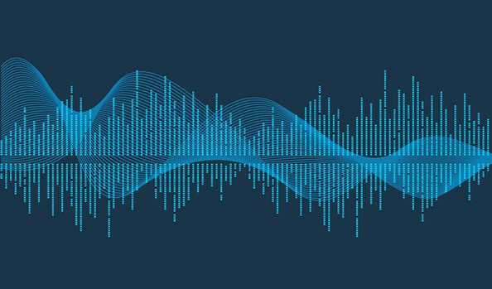
Environmental Corruption and Data Augmentation
Environmental Corruption
Additive Noise
Open-RIRS dataset
Reverberation
Environmental Corruption Lobe
Data Augmentation
Speed Perturbation
Time Dropout
Frequency Dropout
Data Augmentation Lobe

Slide 5
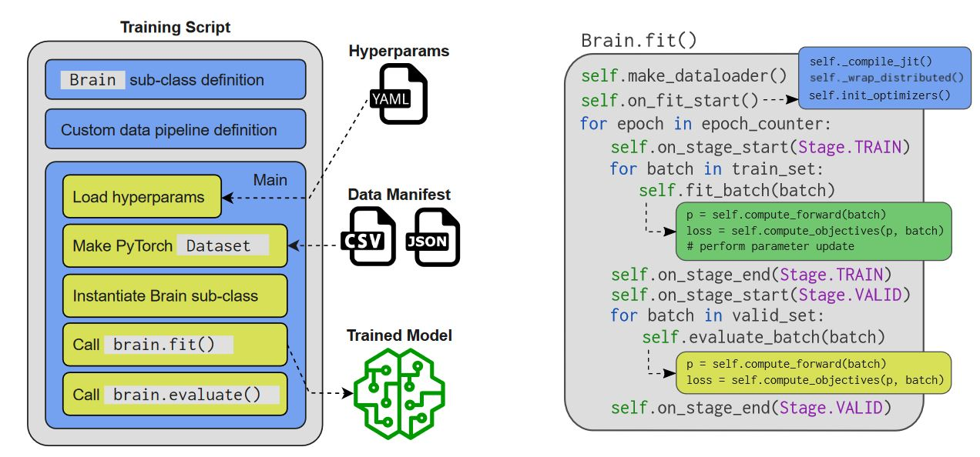
Network Architecture – how the model works
This model uses the open-source toolkit Speechbrain which organises the code used for training in a simple and clear manner.
Splits data into training, validation and testing datasets.
Adjusts weights and biases through transfer learning
Cosine distance similarity is applied to verify the speaker
Source: Desplanques, B., Thienpondt, J., & Demuynck, K. (2020). ECAPA-TDNN: Emphasized Channel Attention, Propagation and Aggregation in TDNN Based Speaker Verification. Interspeech.

Slide 6
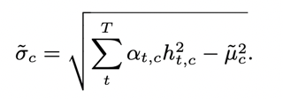
Improvement 1: Channel Dependent Attentive Statistics Pooling
Neural networks learn hierarchical structures
ECAPA-TDNN aggregates and propagates features at different levels
Channel dependent frame attention is also implemented based off the given equation:
σ: channel component
α: importance of each frame
h: local input concatenated with global non-weighted mean
µ: weighted mean vector of a channel

Slide 7
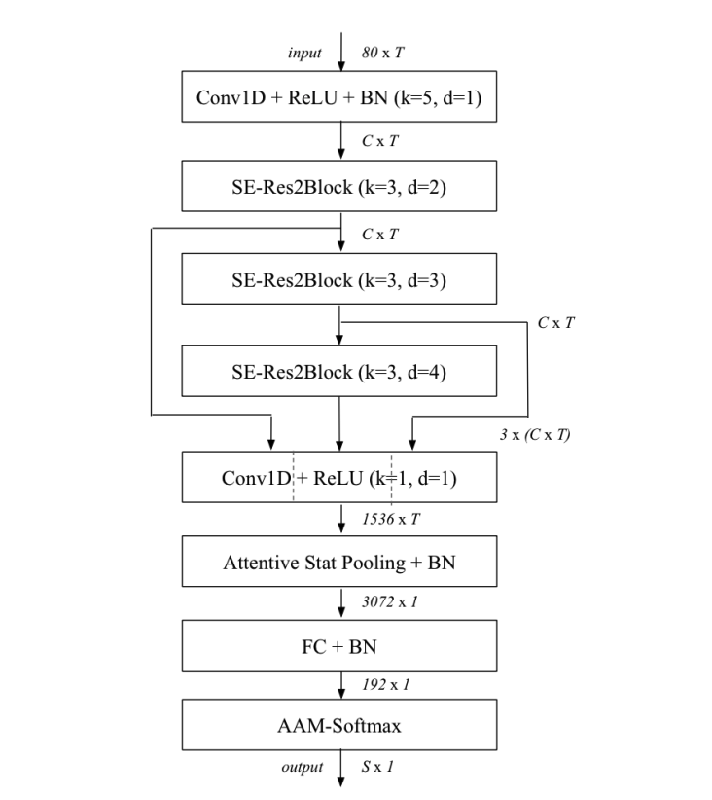
Improvement 2: Multi-layer feature aggregation (MFA)
In the original x-vector system, only the final frame is used for calculating pooled statistics
ECAPA-TDNN model overlooks all frames to calculate pooled statistics
Each output feature map for SE-Res2Blocks are concatenated
Dense layer processes result and generates features for statistics pooling

Slide 8
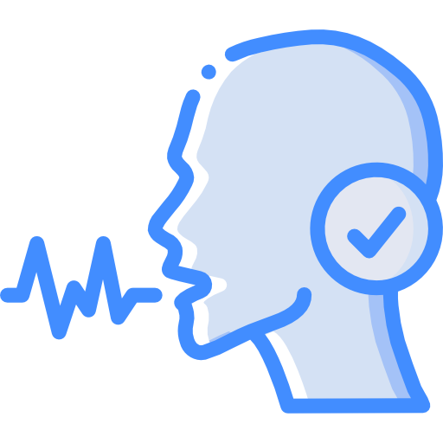
Project Demonstration
Introducing VANET – the Voice Authentication Neural NETwork
VANET provides an interface wherein a user can train the network to their voice, and verify it in real time
Inspired by Google Home/ Siri
Developed to assess the success of our model

Slide 9
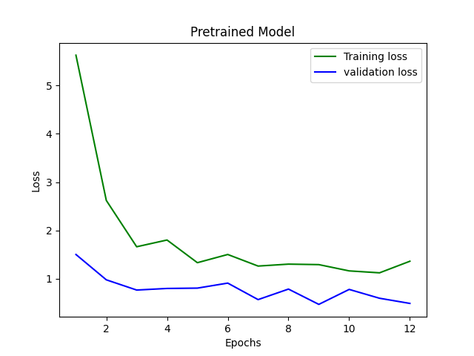
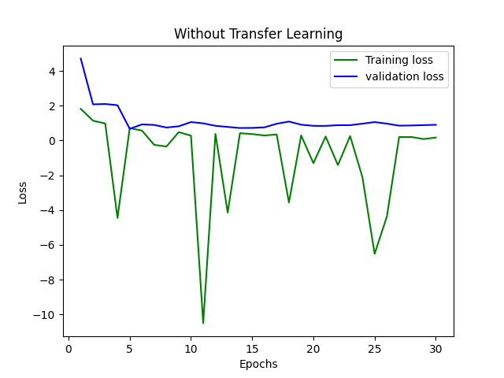
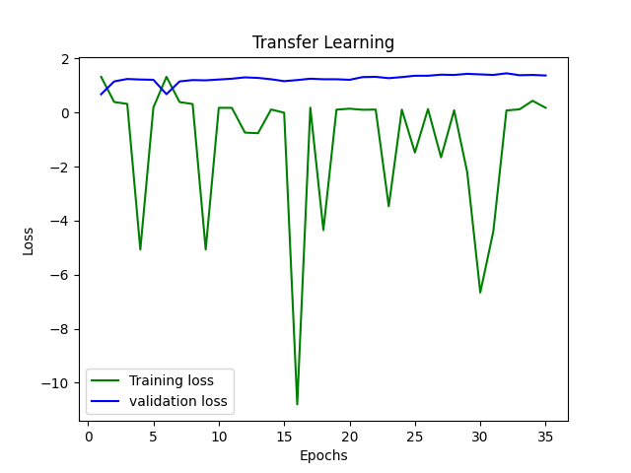
Results and Reflection
Equal Error Rate
Corresponds to equal probability of misclassifying a positive or negative sample; the lower the EER, the higher the accuracy of a biometric system
Pretrained Model: 1.01% EER
Trained Model (with & without TL): Qualitative observations:
Improved computation time

Slide 10
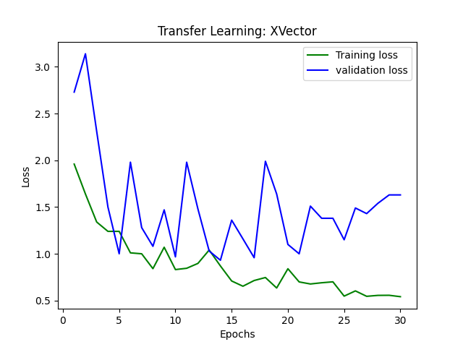
Strengths
Limitations
Baseline comparisons with other models
X-vector Model
Trained to work with degraded and distorted speech
Data Pre-processing: “Clean” Speech Conditions
Data-splitting: Reliability of Performance Statistics
Model Complexity and Underfitting
Cosine Threshold Determination
Size of Training Samples
Biases
Representation Bias in VoxCeleb Dataset
Deployment Bias
Are we truly minimising false positives?

Slide 11
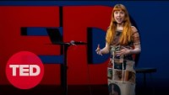
Summary
Constructed an utterance-level classifier from scratch using the SpeechBrain Framework
Future experiments
Neural Style Transfer (Real-Time Voice Cloning)
Holly Herndon’s “What if you could sing in your favorite musician's voice?” TED Talk
Applications of other machine learning algorithms
Random Forests
Decision Trees

Slide 12
References
Bai, Z. & Zhang, X.-L., 2021. Speaker recognition based on deep learning: An overview. Neural Networks: The Official Journal of the International Neural Network Society, 140(2), pp. 65-99.
Chung, J. S. et al., 2019. VoxSRC 2019: The first VoxCeleb Speaker Recognition Challenge. ISCA.
Dawalatabad, N. et al., 2021. ECAPA-TDNN Embeddings for Speaker Diarization. Interspeech.
Desplanques, B., Thienpondt, J. & Demuynck, K., 2020. ECAPA-TDNN: Emphasized Channel Attention, Propagation and Aggregation in TDNN Based Speaker Verification. Interspeech, Volume 3.
Gonon, G., Gribonval, R. & Bimbot, F., 2005. Decision Trees with Improved Efficiency for Fast Speaker Verification. 9th European Conference on Speech Communication and Technology, Interspeech.
Herndon, H., 2022. What if you could sing in your favorite musician's voice?. [Online] Available at: https://www.ted.com/talks/holly_herndon_what_if_you_could_sing_in_your_favorite_musician_s_voice?language=en [Accessed 10 October 2022].
Hutiri, W. T. & Ding, A. Y., 2022. Bias in Automated Speaker Recognition. FAccT.
K, K. N., Barik, M. K. & Khan, A. N., 2021. Speaker Recognition using Random Forest. ITM Web of Conferences, Volume 37.
Liu, T., Das, R. K., Lee, K. A. & Li, H., 2022. MFA: TDNN with Multi-scale Frequency-channel Attention for Text-independent Speaker Verification with Short Utterances. ICASSP 2022, Volume 3.
Nagrani, A., Chung, J. S. & Zisserman, A., 2017. VoxCeleb, A Large-Scale Speaker Identification Dataset. Interspeech.
Nagrani, A., Chung, J. S. & Zisserman, A., 2018. VoxCeleb2: Deep Speaker Recognition. Interspeech.
Peddinti, V., Povey, D. & Seltzer, M., 2017. A Study on Data Augmentation of Reverberant Speech for Robust Speech Recognition. ICASSP 2017 - 2017 IEEE International Conference on Acoustics, Speech and Signal Processing (ICASSP).
Sainburg, T., 2022. NoiseReduce 2.0.1, Noise reduction in python using spectral gating. [Online] Available at: https://pypi.org/project/noisereduce/ [Accessed 15 November 2022].
SciKit, 2022. 3.1. Cross-validation: evaluating estimator performance. [Online] Available at: https://scikit-learn.org/stable/modules/cross_validation.html [Accessed 11 November 2022].

Slide 13
Questions?

